Slide 1
Instructor Materials Chapter 4: Network Addressing
Networking Essentials
Notes:
Cisco Networking Academy Program
Networking Essentials
Chapter 4: Network Addressing

Slide 2
Instructor Materials – Chapter 4 Planning Guide
This PowerPoint deck is divided in two parts:
Instructor Planning Guide
Information to help you become familiar with the chapter
Teaching aids
Instructor Class Presentation
Optional slides that you can use in the classroom
Begins on slide # 8
Note: Remove the Planning Guide from this presentation before sharing with anyone.
Notes:
2

Slide 3
Networking Essentials
Instructor Planning Guide
Chapter 4: Network Addressing
Notes:
Networking Essentials Planning Guide
Chapter 4: Network Addressing

Slide 4
Chapter 4: Activities
What activities are associated with this chapter?
Page # | Activity Type | Activity Name
4.1.1.2 | Packet Tracer | Connecting to a Web Server
4.1.3.2 | Interactive Activity | Network Addresses
4.1.4.3 | Lab | Using Windows Calculator for Binary Conversions
4.2.2.3 | Interactive Activity | Public or Private
4.2.3.4 | Interactive Activity | Who Gets this Message?
4.3.3.3 | Packet Tracer | Configure DHCP on a Wireless Router
4.4.3.2 | Packet Tracer | Examine NAT on a Wireless Router
4.5.2.4 | Interactive Activity | IPv6 Address Notation
The password used in the Packet Tracer activities in this chapter is: PT_net1
Notes:
4

Slide 5
Chapter 4: Assessment
Students should complete Chapter 4, “Assessment” after completing Chapter 4.
Quizzes, labs, Packet Tracers and other activities can be used to informally assess student progress.
Notes:
5

Slide 6
Chapter 4: Additional Help
For additional help with teaching strategies, including lesson plans, analogies for difficult concepts, and discussion topics, visit the Facebook page for community and peer support at the following: www.facebook.com/cisconetworkingacademy.
Notes:
6

Slide 7
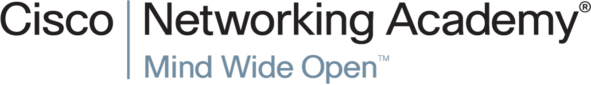

Slide 8
Chapter 4: Network Addressing
Networking Essentials
Notes:
Cisco Networking Academy Program
Networking Essentials
Chapter 4: Network Addressing

Slide 9
Chapter 4 - Sections & Objectives
4.1 IPv4 Addresses and Subnet Masks
Explain the features of an IPv4 address.
4.2 Types of IPv4 Addresses
Explain the features of the different types of IPv4 addresses.
4.3 How IPv4 Addresses are Obtained
Configure a DHCP server.
4.4 IPv4 Address Management
Explain the need for public and private addressing.
4.5 Addressing with IPv6
Explain the need for IPv6.
Notes:
9

Slide 10
4.1 IPv4 Addresses and Subnet Masks
Notes:
Cisco Networking Academy Program
Networking Essentials
Chapter 4: Network Addressing

Slide 11
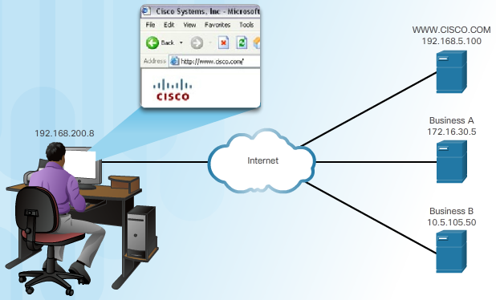
IPv4 Addresses and Subnet Masks Purpose of the IPv4 Address
What is an IPv4 Address?
Is a logical network address that identifies a particular host
Configured and is unique on the network for communications
Is associated with a network interface card
Notes:
4.1 – IPv4 Addresses and Subnet Masks
4.1.1 – Purpose of the IPv4 Address

Slide 12
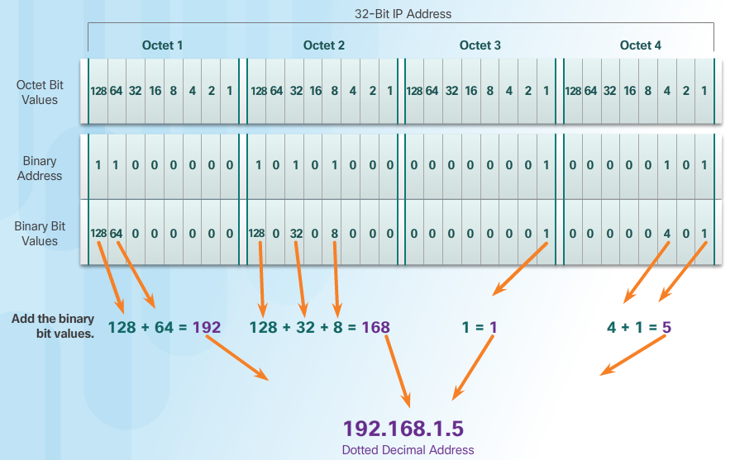
IPv4 Addresses and Subnet Masks IP Address Structure
IPv4 Addressing
32 binary bits
For ease of use, the 32 bits are group into four 8-bit bytes called octets.
The octets are represented in dotted-decimal notation.
Binary to Decimal
Notes:
4.1 – IPv4 Addresses and Subnet Masks
4.1.2 – IP Address Structure

Slide 13
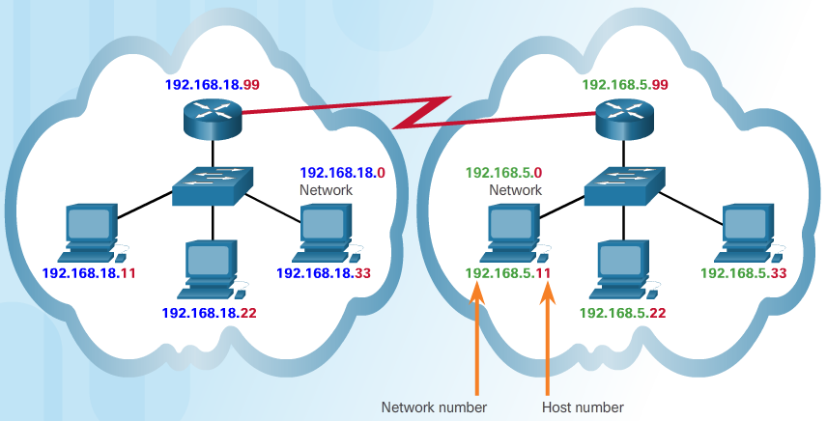
IPv4 Addresses and Subnet Masks Parts of an IP Address
Networks and Hosts
Logical 32-bit IPv4 address is hierarchical and is made up of two parts
Network
Host
Notes:
4.1 – IPv4 Addresses and Subnet Masks
4.1.3 – Parts of an IP Address

Slide 14
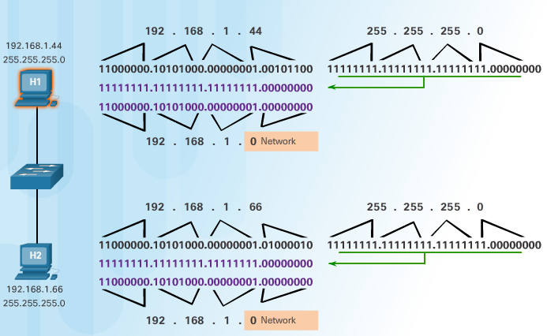
IPv4 Addresses and Subnet Masks How IP Addresses and Subnet Masks Interact
Are You on My Network?
When a host sends a packet, it compares its subnet mask to its own IPv4 address and the destination IPv4 address.
Subnet Masks
Common subnet masks: 255.0.0.0 (8-bits), 255.255.0.0 (16 bits) and 255.255.255.0 (24 bits).
Number of hosts: 2^{x} - 2
Notes:
4.1 – IPv4 Addresses and Subnet Masks
4.1.4 – How IP Addresses and Subnet Masks Interact

Slide 15
4.2 Types of IPv4 Addresses
Notes:
Cisco Networking Academy Program
Networking Essentials
Chapter 4: Network Addressing

Slide 16
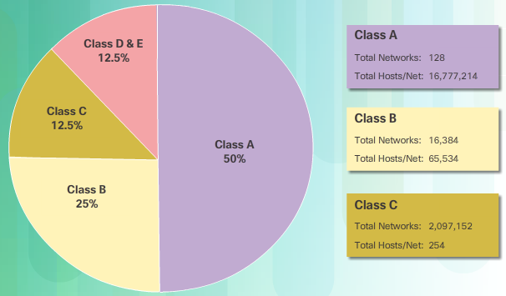
Types of IPv4 Addresses IPv4 Address Classes and Default Subnet Masks
Classful Addressing
Class A (0.0.0.0/8 to 127.0.0.0/8) supports extremely large networks.
Class B (128.0.0.0 /16 – 191.255.0.0 /16) supports the needs of moderate to large size networks.
Class C (192.0.0.0 /24 – 223.255.255.0 /24) supports small networks with a maximum of 254 hosts.
Classless Addressing
IPv4 addresses allocated on any address bit boundary
Delays the depletion and exhaustion of IPv4 addresses
Classless Inter-Domain
Routing (CIDR)
Notes:
4.2 – Types of IPv4 Addresses
4.2.1 – IPv4 Address Classes and Default Subnet Masks

Slide 17

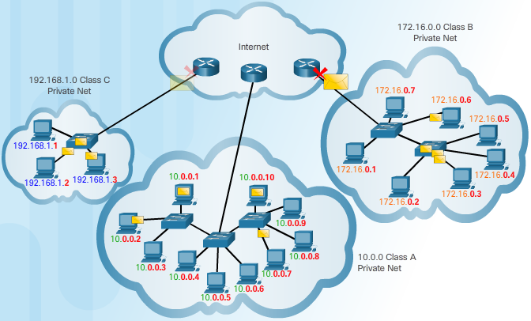
Types of IPv4 Addresses Public and Private IP Addresses
Private IPv4 Addressing
Using Private IPv4 Addresses
Does not connect directly to the Internet
Visible on local network only
Loopback address: 127.0.0.0 network
Notes:
4.2 – Types of IPv4 Addresses
4.2.2 – Public and Private IP Addresses

Slide 18
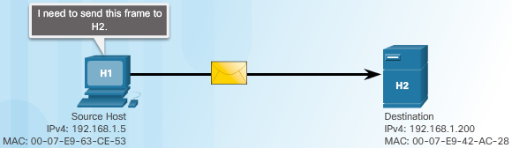
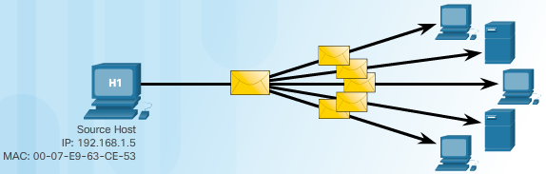
Types of IPv4 Addresses Unicast, Broadcast and Multicast Addresses
A Message for Me
Unique destination MAC and IP addresses
Something for Everyone
Broadcast MAC and IP address:
MAC address: FFFF:FFFF:FFFF
Host portion of IP Address is all 1s
Notes:
4.2 – Types of IPv4 Addresses
4.2.3 – Unicast, Broadcast and Multicast Addresses

Slide 19
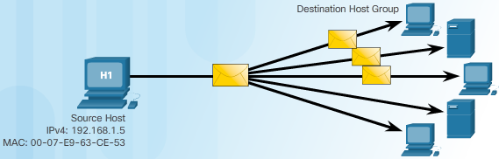
Types of IPv4 Addresses Unicast, Broadcast and Multicast Addresses (Cont.)
Just for this Group
A single packet is sent to a selected set of hosts in the multicast group
Reserved IPv4 address
Reserved multicast range: 224.0.0.0 to 239.255.255.255
Reserved multicast range on local network: 224.0.0.0 to 224.0.0.255
Notes:
4.2 – Types of IPv4 Addresses
4.2.3 – Unicast, Broadcast and Multicast Addresses (Cont.)

Slide 20
4.3 How IPv4 Addresses are Obtained
Notes:
Cisco Networking Academy Program
Networking Essentials
Chapter 4: Network Addressing

Slide 21
How IPv4 Addresses are Obtained Static and Dynamic Address Assignment
Assigning Addresses
Can be done statically or dynamically
Assign an IPv4 address, subnet mask, default gateway and other necessary info for network communications
Static IPv4 addresses:
Hosts, such as servers and printers, that need particular addresses
Can be time consuming and error prone
Need to maintain an accurate list of which IPv4 addresses
Dynamic IPv4 Address Assignment
Dynamic Host Configuration Protocol (DHCP) allows for automatic assignment of addressing information
Preferred method of assignment for a large network
IP addresses can be reallocated when they become available
Notes:
4.3 – How IPv4 Addresses are Obtained
4.3.1 – Static and Dynamic Address Assignment

Slide 22
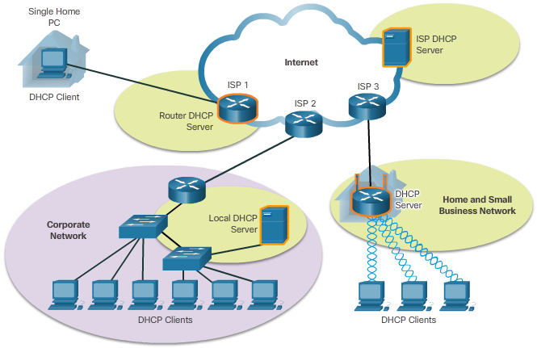
How IPv4 Addresses are Obtained DHCP Servers
Where Do DHCP Addresses Come From?
Medium to large network
Usually a local dedicated PC-based server
Home network
A wireless router can serve as a client to receive IP configuration information from the ISP
A wireless router can act as a DHCP server for the hosts in the local network
Notes:
4.3 – How IPv4 Addresses are Obtained
4.3.2 – DHCP Servers

Slide 23
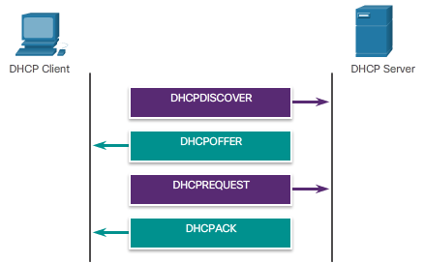
How IPv4 Addresses are Obtained Configuring DHCP
How Does IPv4 DHCP Work?
Client sends a DHCP Discover message.
A destination IPv4 address of 255.255.255.255 (32 ones)
A destination MAC address of FF-FF-FF-FF-FF-FF (48 ones).
DHCP server will respond with a DHCP Offer, suggesting an IPv4 address for the client.
The host sends a DHCP Request to that server asking to use the suggested IPv4 address.
The server responds with a DHCP Acknowledgment.
Notes:
4.3 – How IPv4 Addresses are Obtained
4.3.3 – Configuring DHCP

Slide 24
4.4 IPv4 Address Management
Notes:
Cisco Networking Academy Program
Networking Essentials
Chapter 4: Network Addressing

Slide 25
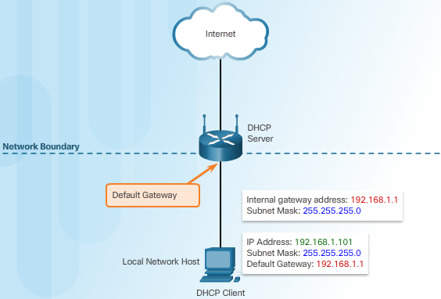
IPv4 Address Management Network Boundaries and Address Space
Gateways to Other Networks
Each host on a network uses a default gateway to reach other networks.
The default gateway is the IPv4 address of the router interface connected to the network where the host is attached
Notes:
4.4 – IPv4 Address Management
4.4.1 – Network Boundaries and Address Space

Slide 26
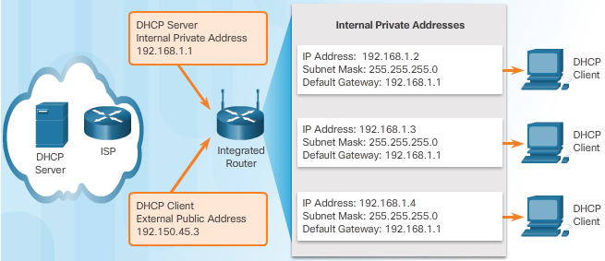
IPv4 Address Management Address Assignment
Who is on the Inside?
Internal hosts must be assigned addresses within the same network as the integrated router statically or through DHCP. It also provides IPv4 address, subnet mask, default gateway and other network information.
The network assigned to the Internet side of the integrated router is referred to as the external, or outside, network. ISPs usually provide an Internet-routable address, which enables hosts connected to the integrated router to have access to the Internet.
The integrated router serves as the boundary between the local internal network and the external Internet.
Notes:
4.4 – IPv4 Address Management
4.4.2 – Address Assignment

Slide 27
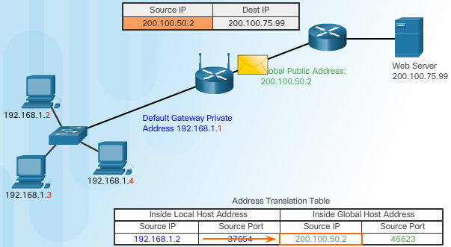
IPv4 Address Management Network Address Translation
From IPv4 Private to Public Addresses
Network Address Translation
Translate private addresses into unique Internet-routable public addresses for outgoing packets
The process is reversed for incoming packets
The router can translate many internal IPv4 addresses to the same public address
Notes:
4.4 – IPv4 Address Management
4.4.3 – Network Address Translation

Slide 28
4.5 Addressing with IPv6
Notes:
Cisco Networking Academy Program
Networking Essentials
Chapter 4: Network Addressing

Slide 29
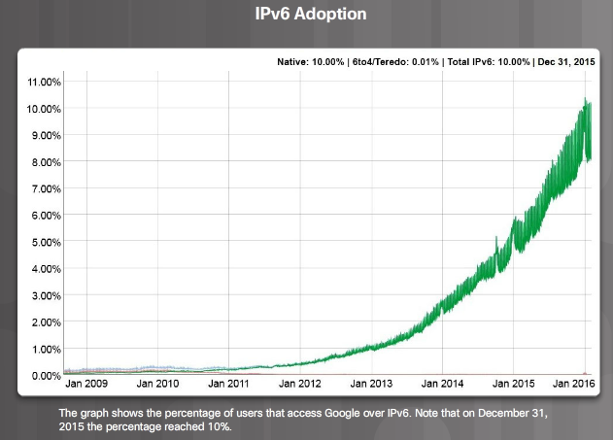
Addressing with IPv6 Are You Ready for Change?
Need more IP addresses
An IPv4 address is 32 bits (4 bytes) long.
An IPv6 address is 128 bits (16 bytes) in length.
IPv6 benefits
More IP addresses
No need for NAT
Autoconfiguration capabilities
Change is Coming
NAT has prolonged the life of IPv4
IPv6 adoption rate is increasing
Notes:
4.5 – Addressing with IPv6
4.5.1 – Are You Ready for Change?

Slide 30

Addressing with IPv6 How is IPv6 Different?
IPv6 Differences
Address autoconfiguration
Link-local address
Communications within the same network
IPv6 Address Formatting
Compressing IPv6 Addresses Rules
Omit Leading Zeros
Omit One “all zero” Segment
Notes:
4.5 – Addressing with IPv6
4.5.2 – How is IPv6 Different?

Slide 32
